Slide 1
Interpretability Papers
CNN, Game-Theoretic, NLP
1901210094 文中扬

Slide 2
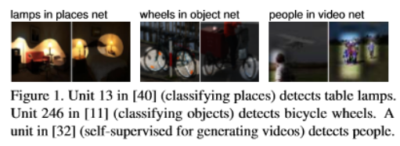
1. Network Dissection: Quantifying Interpretability of Deep Visual Representations
1.1 Introduction
Propose a general framework called Network Dissection for quantifying the interpretability of latent representations of CNNs
“Disentangled representations”

Slide 3
1.2 Network Dissection
Three steps:
(1) Identify a broad set of human-labeled visual concepts
(2) Gather hidden variables’ response to known concepts
(3) Quantify alignment of hidden variable−concept pairs
1.2.1 Broden: Broadly and Densely Labeled Dataset
Unifies several densely labeled image datasets: ADE[43], OpenSurfaces [4], Pascal-Context [19], Pascal-Part [6], and the Describable Textures Dataset [7]
Contain examples of a broad range of objects, scenes, object parts, textures, and materials in a variety of contexts
Every image pixel in the data set is annotated with one of the eleven common color names according to the human perceptions classiﬁed by van de Weijer [31]

Slide 4
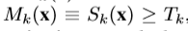
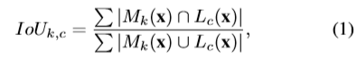
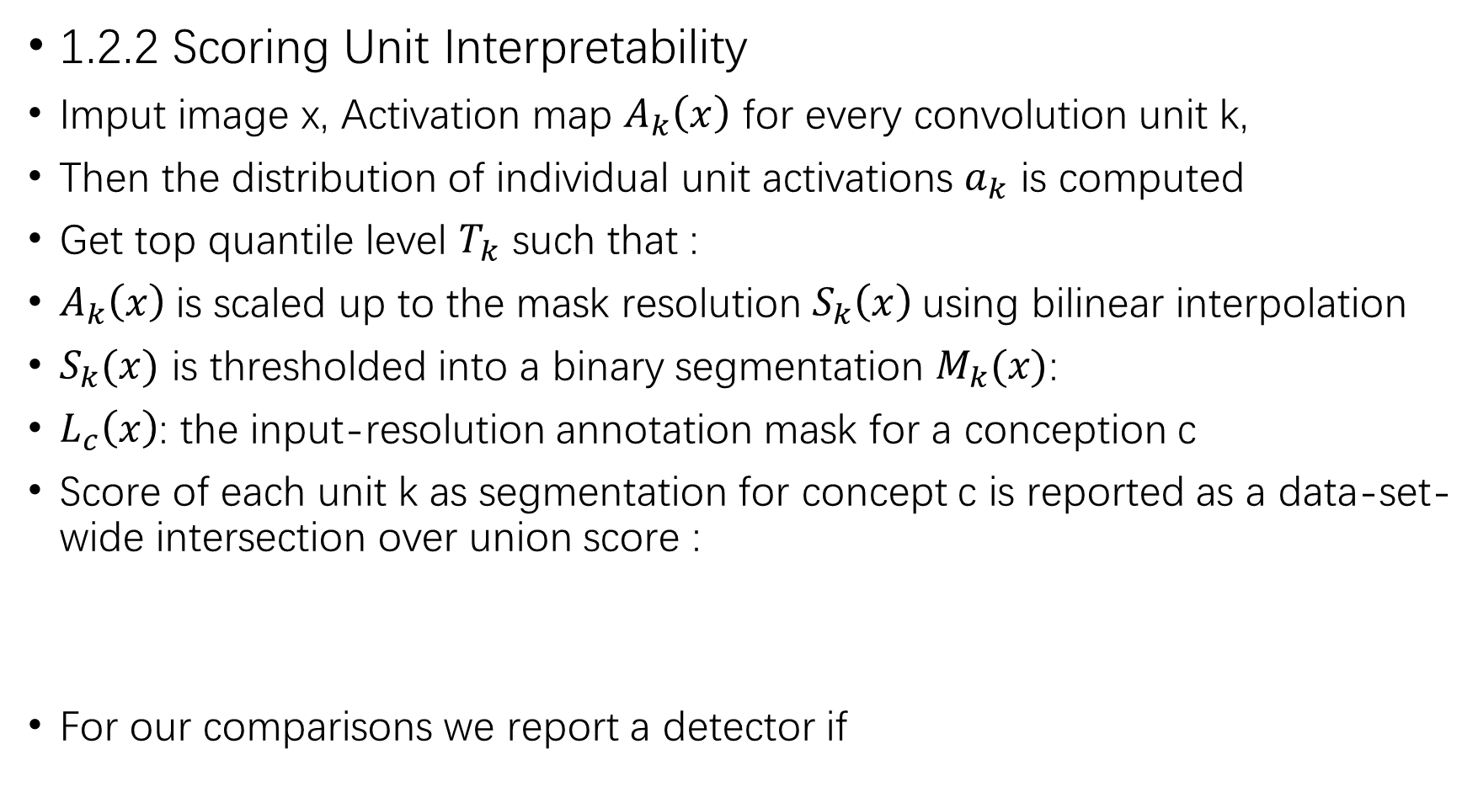
1.2.2 Scoring Unit Interpretability
Imput image x, Activation map $A_{k}\left(x\right)$ for every convolution unit k,
Then the distribution of individual unit activations $a_{k}$ is computed
Get top quantile level $T_{k}$ such that :
$A_{k}\left(x\right)$is scaled up to the mask resolution $S_{k}\left(x\right)$using bilinear interpolation
$S_{k}(x)$ is thresholded into a binary segmentation $M_{k}(x)$:
$L_{c}\left(x\right)$: the input-resolution annotation mask for a conception c
Score of each unit k as segmentation for concept c is reported as a data-set-wide intersection over union score :
For our comparisons we report a detector if

Slide 5
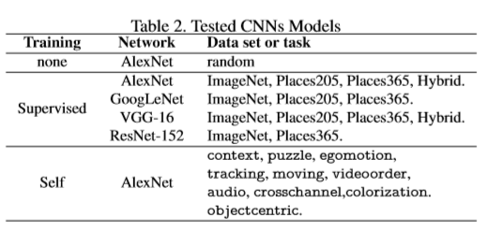
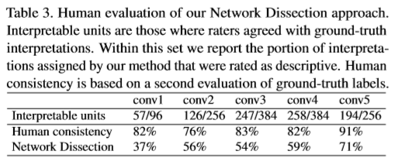
1.3 Experiments
Different architectures:
Human Evaluation of Interpretations

Slide 6
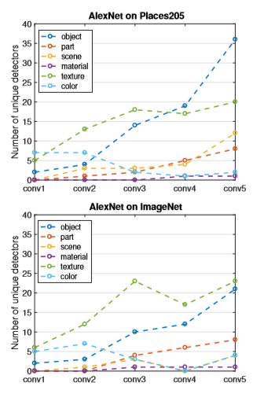
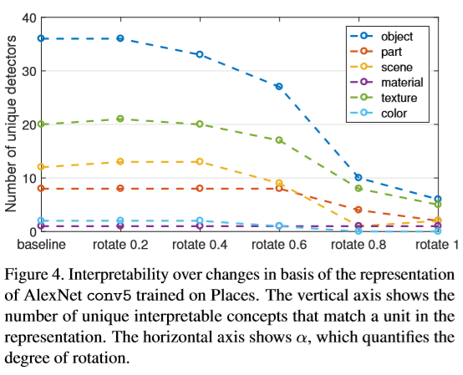
(2) Measurement of Axis-Aligned Interpretability
(3) Disentangled Concepts by Layer

Slide 7
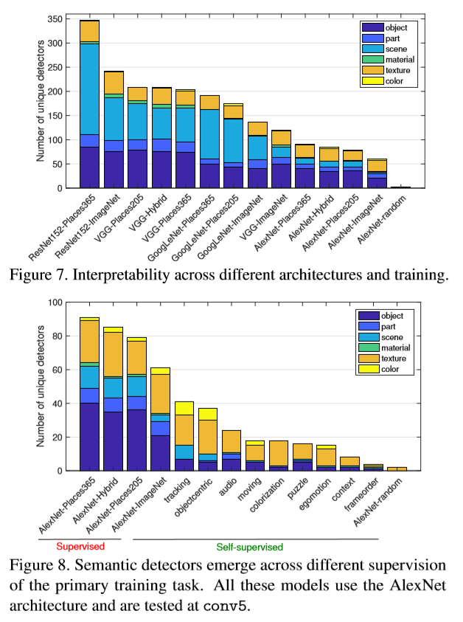
(4) Network Architectures and Supervisions
(5) Training Conditions vs. Interpretability
(6) Discrimination vs. Interpretability
(7) Layer Width vs. Interpretability

Slide 8
2. Interpretable Basis Decomposition for Visual Explanation
2.1 Introduction
Two approaches for human-understandable explanations for the internals of a deep network:
(1) Identify the evidence that a network uses to make a specific decision by creating a heatmap that indicates which portions of an input are most salient to the decision [2,20,28].
(2) Identify the purpose of the internal representations of a network by identifying the concepts that each part of the network detects [3,7,27].
IBD framework bring these two approaches together to generate explanations for visual recognition

Slide 9
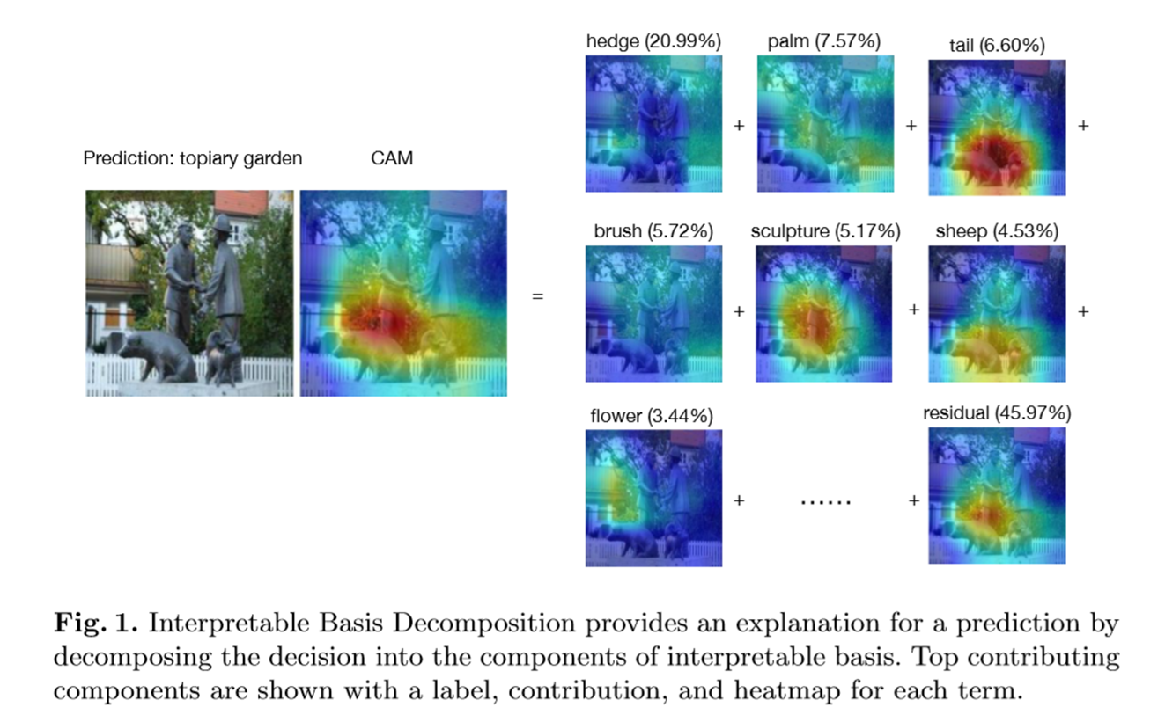
Work:
(1) A new framework called Interpretable Basis Decomposition to provide semantic explanations with labels and heatmaps for neural decision making
(2) Application of the proposed framework on a wide range of network architectures, showing its general applicability
(3) Human evaluations to demonstrate that the explanations are understandable to people, outperforming previous heatmap and unit-based explanation methods

Slide 10
2.2 Framework
Class Activating Map(CAM) (Learning Deep Features for Discriminative Localization)

Slide 11
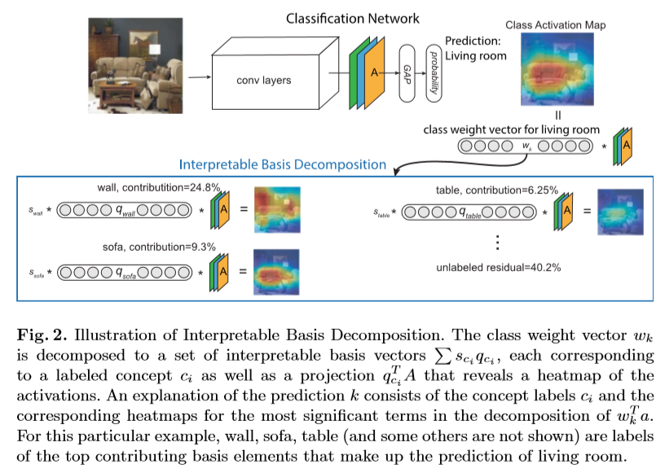
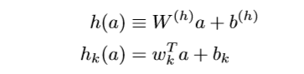
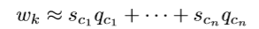
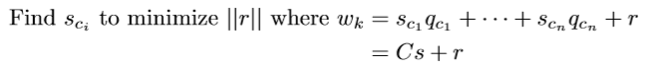
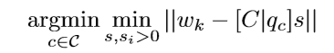
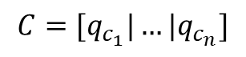
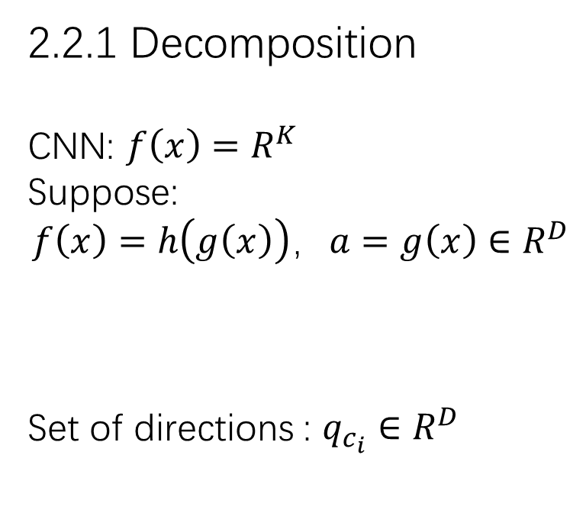
2.2.1 Decomposition
CNN: $f\left(x\right)=R^{K}$
Suppose:
$$f\left(x\right)=h\left(g\left(x\right)\right)，a=g\left(x\right)∈R^{D}$$
Set of directions : $q_{c_{i}}∈R^{D}$
$$C=[q_{c_{1}}|…|q_{c_{n}}]$$

Slide 12
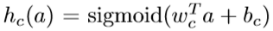
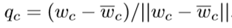
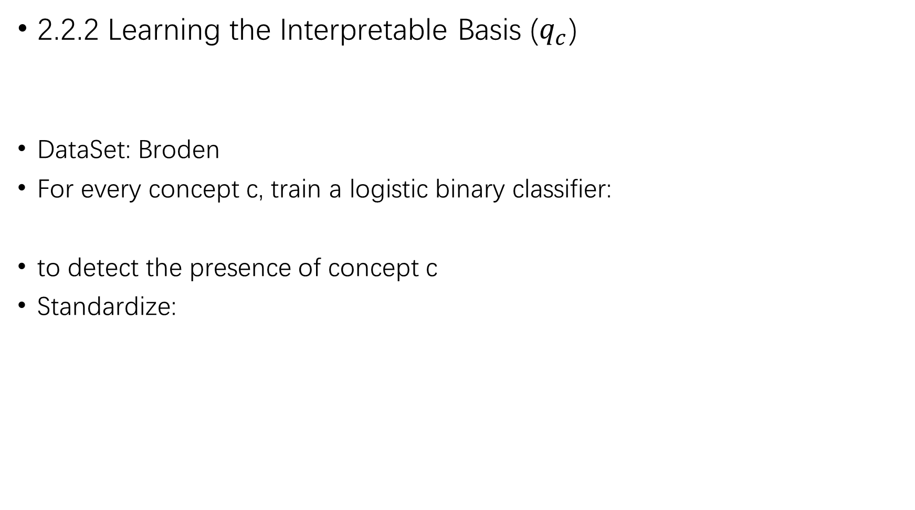
2.2.2 Learning the Interpretable Basis ($q_{c}$)
DataSet: Broden
For every concept c, train a logistic binary classifier:
to detect the presence of concept c
Standardize:

Slide 13
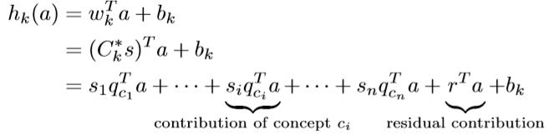
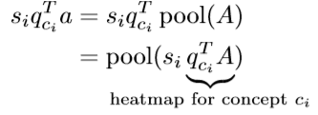
2.2.3 Explaining a Prediction via IBD

Slide 14
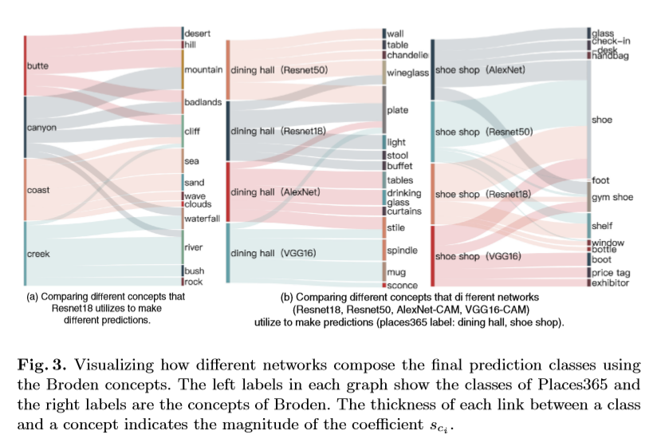
2.3 Experiments
(1) Explaining Classification Decision Boundaries(for different CNNs)

Slide 15
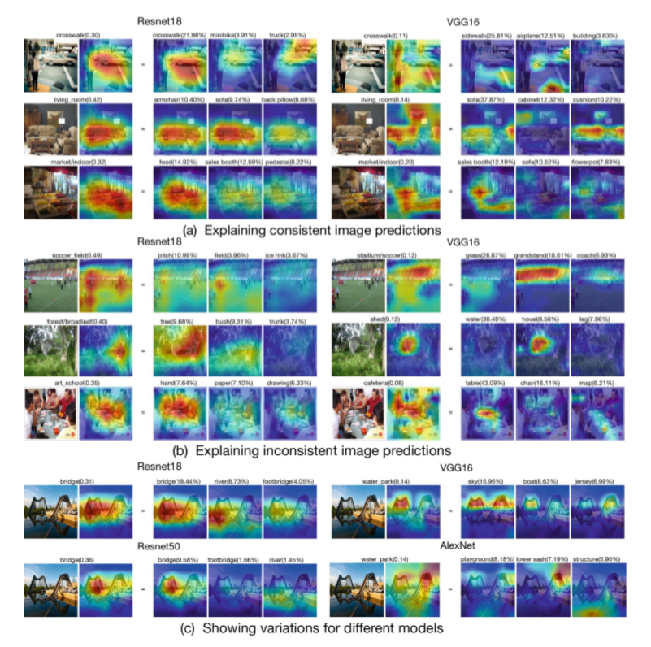
(2) Explaining Image Predictions

Slide 16
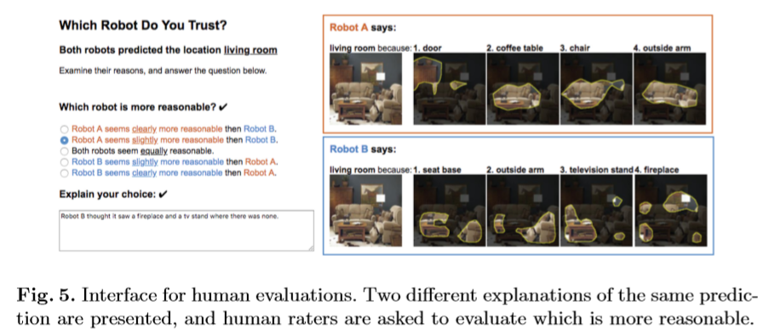
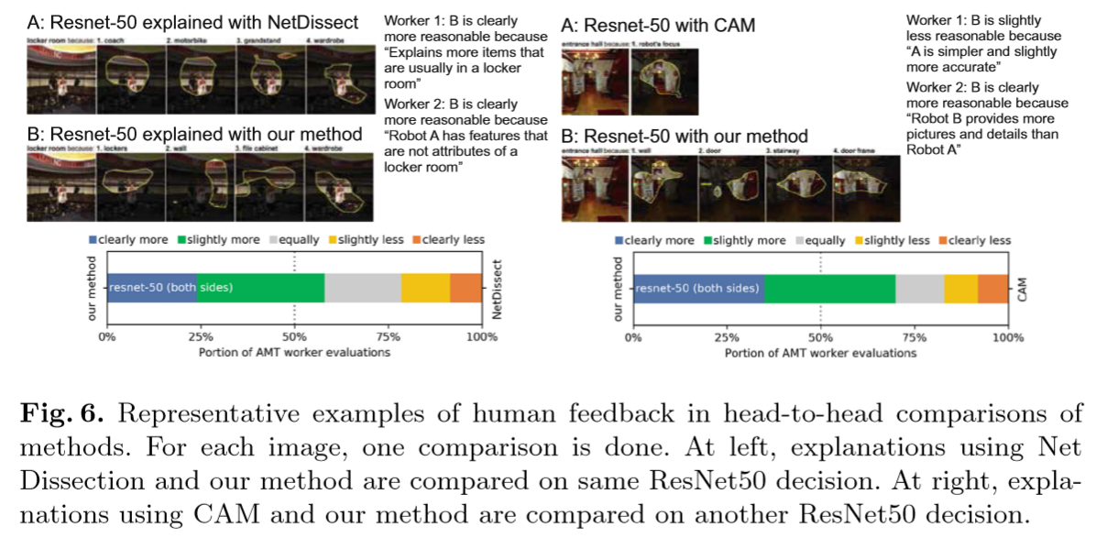
(3) Human
Evaluation

Slide 17
3. Interpretable Representation Learning for Visual Intelligence (phd thesis, Bolei Zhou)
https://m.youtube.com/watch?v=J7Zz_33ZeJc

Slide 18
4. Game-Theoretic interpretability
Game-Theoretic Interpretability for Temporal Modeling
Functional Transparency for Structured Data: a Game-Theoretic Approach

Slide 19
4.1 Introduction
Functional transparency: to guide models to adopt a desirable local behavior yet allowing them to be more flexible globally
Contribution:
1. A novel game-theoretic approach to transparency, applicable to a wide range of prediction models, architectures, and local transparency classes, without requiring differentiability
2. Analysis on the effective size of the local regions and establishing equilibria pertaining to different game formulations
3. Illustration of deep models across several tasks, from chemical property prediction, physical component modeling, to molecule representation learning

Slide 20
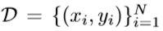
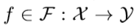
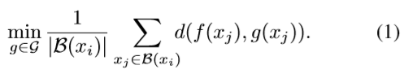
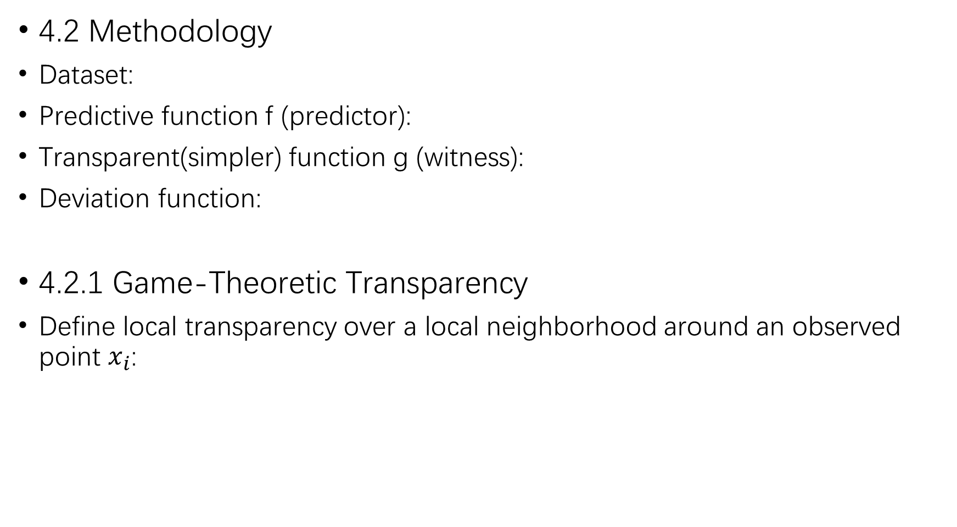
4.2 Methodology
Dataset:
Predictive function f (predictor):
Transparent(simpler) function g (witness):
Deviation function:
4.2.1 Game-Theoretic Transparency
Define local transparency over a local neighborhood around an observed point $x_{i}$:

Slide 21
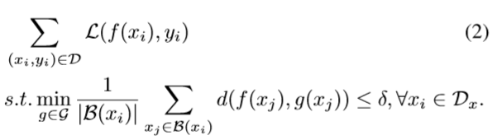
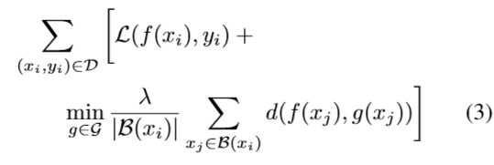
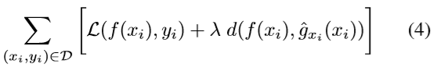
Uniform criterion:
Symmetric game:
Asymmetric game:

Slide 22
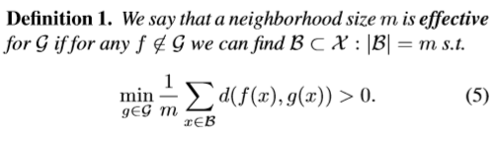
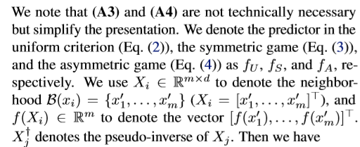
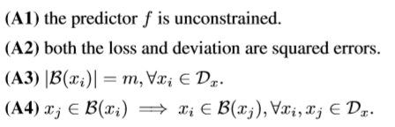
3.2.2 Analysis
Neighborhood size:
Equilibrium solutions：

Slide 23
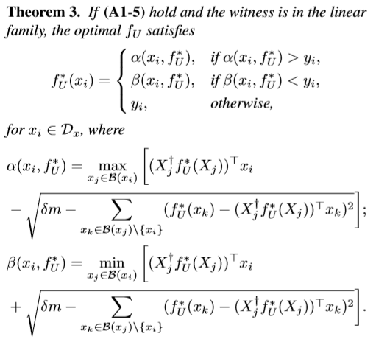
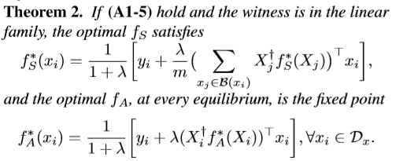
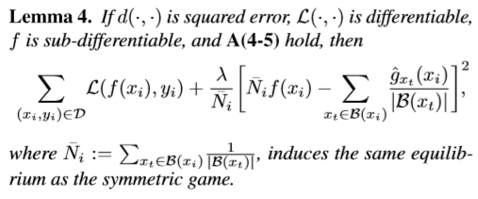
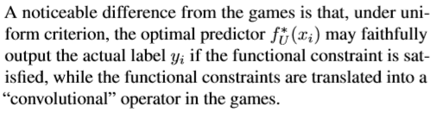
Efficient computation

Slide 24
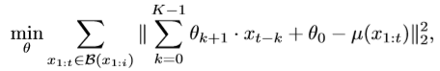
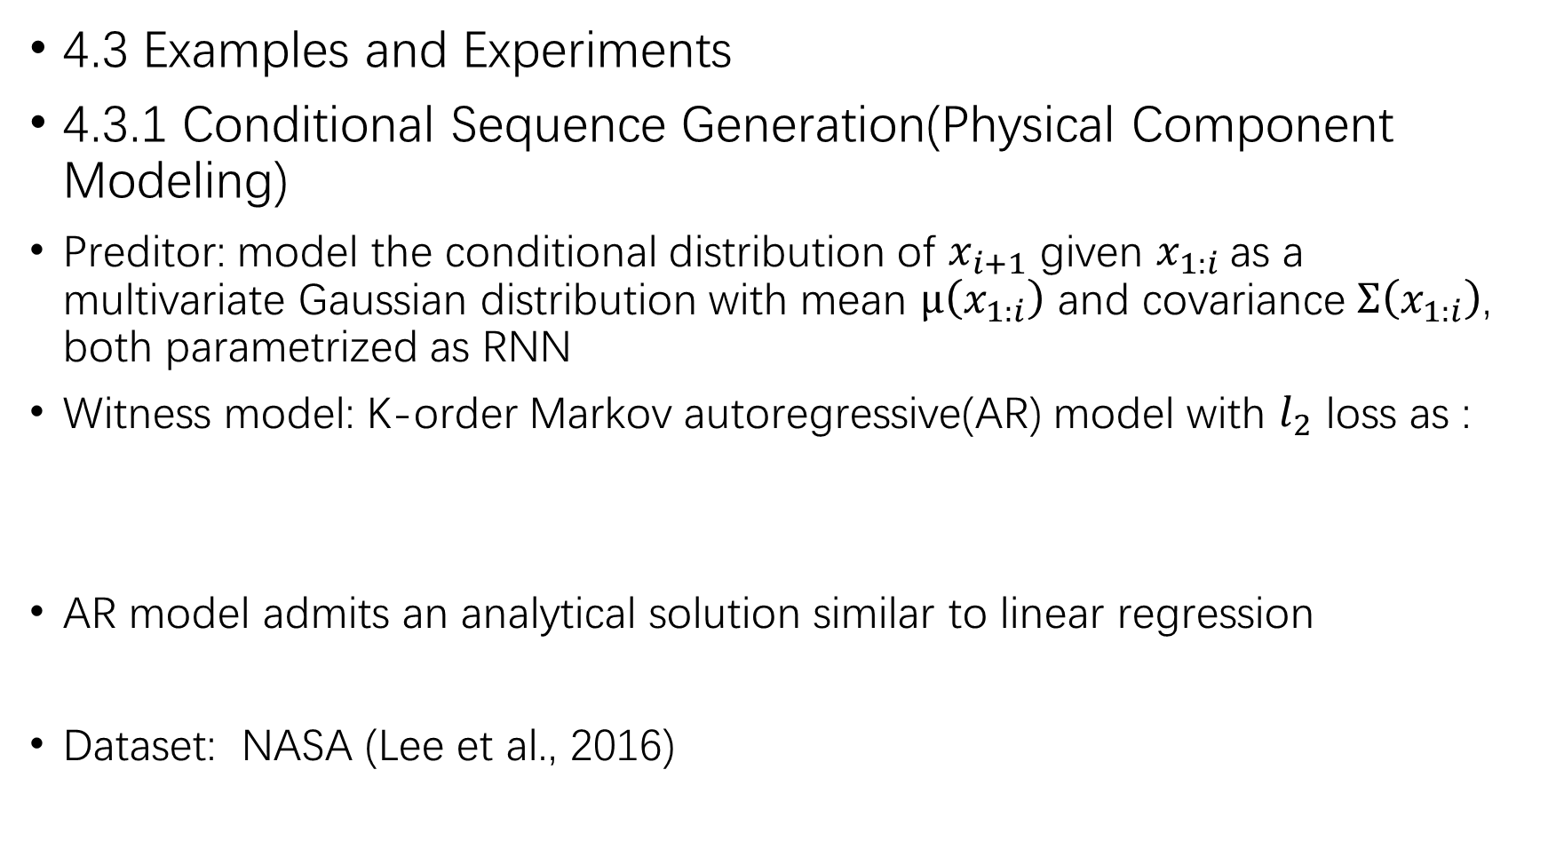
4.3 Examples and Experiments
4.3.1 Conditional Sequence Generation(Physical Component Modeling)
Preditor: model the conditional distribution of $x_{i+1}$ given $x_{1:i}$as a multivariate Gaussian distribution with mean $μ\left(x_{1:i}\right)$ and covariance $Σ\left(x_{1:i}\right)$, both parametrized as RNN
Witness model: K-order Markov autoregressive(AR) model with $l_{2}$ loss as :
AR model admits an analytical solution similar to linear regression
Dataset: NASA (Lee et al., 2016)

Slide 25
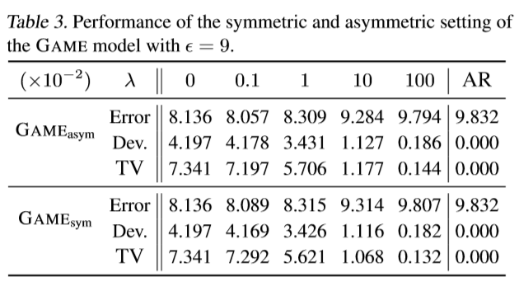
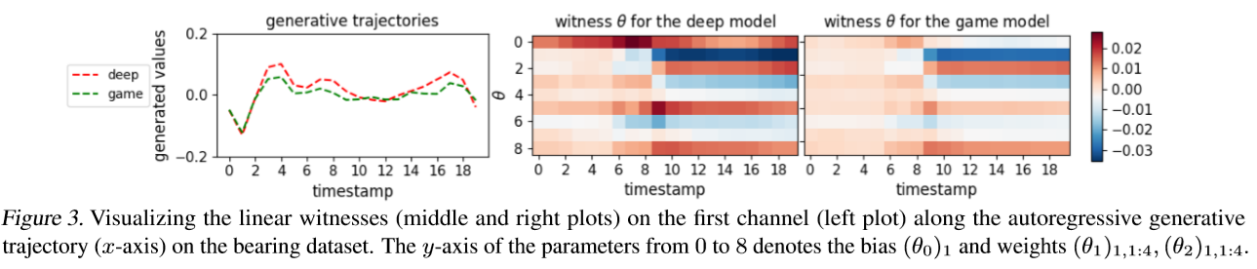

Slide 26
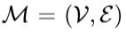
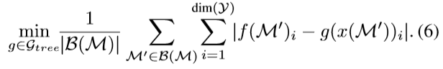
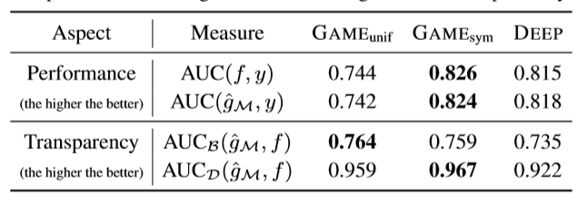
4.3.2 Chemical Property Prediction
Highly structured data:
Predictor: GCNs (Dai et al., 2016; Lei et al., 2017)
Witness: decision tree
Results

Slide 27
5. Is Attention Interpretable?
5.1 Introduction
This work apply a different analysis based on intermediate representation erasure to assess whether attention weights can instead be relied upon to explain the relative importance of the inputs to the attention layer itself.
We find similar cause for concern: attention weights are only noisy predictors of even intermediate components’ importance, and should not be treated as justification for a decision.

Slide 28
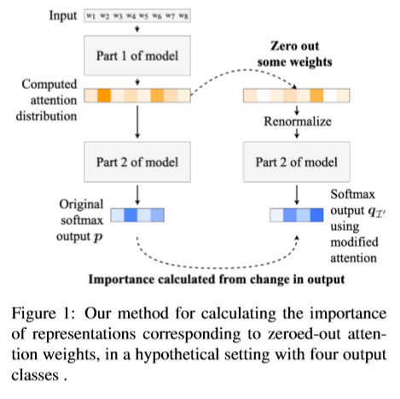
5.2 Intermediate Representation Erasure
Run the classification layer of the model twice : once without any modification, and once after renormalizing the attention distribution with some attention weights zeroed out.
By examining only how well attention represents the importance of intermediate quantities, which may themselves already have changed uninterpretably from the model’s inputs, we are testing for a relatively low level of interpretability.

Slide 29
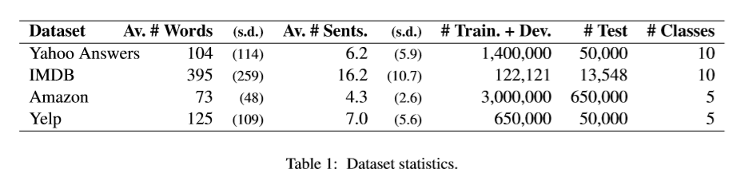
5.3 Data and Model
a topic classification dataset Yahoo Answers and three review ratings datasets: IMDB, Yelp and Amazon
Four Models inspired by the hierarchical attention network (HAN; Yang et al., 2016), a text classification model with two layers of attention, first to the word tokens in each sentence and then to the resulting sentence representations. The layer that classifies the document representation is linear with a softmax at the end.

Slide 30
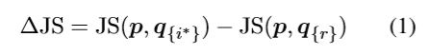


5.4 Experiment
5.4.1 Single Attention Weights’ Importance

Slide 31
5.4.2 Importance of Sets of Attention Weights
Alternative Importance Rankings
1. Randomly
2. Attention
3. by the gradient of the decision function
4. multiply gradient with attention
What is clear is that in the settings we have examined, attention is not an optimal method of identifying which attended elements are responsible for an output. Attention may yet be interpretable in other ways, but as an importance ranking, it fails to explain model decisions.

Slide 32
6. A causal framework for explaining the predictions of black-box sequence-to-sequence models
6.1 Introduction
Interpretability: prediction interpretability
1) Propose a general framework for explaining structured black-box models
2) For sequential data, propose a variational autoencoder for controlled generation of input perturbations required for causal analysis
3) Evaluate the explanations produced by our framework on various sequence-to-sequence prediction tasks

Slide 33



6.2 Structed-output causal retionalizer (SOCRAT)
Black-box model F: X → Y , x∈X, y∈Y, x={x1,x2…xn}, y={y1,y2…ym}
Identify whether token xi is a likely cause for the occurrence of yj in the output when the input context is x. Following (Ribeiro et al., 2016)
Summarize the behavior of F around x in terms of a weighted bipartite graph
Formalize these components as subgraphs
An explanation of y
3 main components of the framework
1) a perturbation model for exercising F locally
2) a causal inference model for inferring associations
3) a selection step (select most relevant sets of associations)

Slide 34



6.2.1 Perturbation Model
Train a VAE
Encoder $ENC: X→R^{d}$ Decoder $DEC:R^{d}→$ X
Result: N pairs of perturbed input-output pairs

Slide 35




6.2.2 Causal model
Let be a binary vector encoding the presence of the original tokens $x_{1},x_{2},x_{3}…x_{n}$ ,for each target token $y_{i}$ estimate a model:
Use Gaussian approximation for the logarithm of the logistic function together with the prior $p\left(θ\right)=N(θ_{0},H_{0}^{−1})$ (Murphy,2012)
Result: dependency coefficients {$θ_{ij}$}, along with their uncertainty estimates
6.2.3 Explanation Selection
How to select a set explanations for (x,y)
Partition the vertex set of G into disjoint subsets so as to minimize the weight of omitted edges (i.e. the k-cut value of the partition)
Rely on the approach of Fan et al. (2012) designed for interval estimates of edge weights.

Slide 36


6.3 Experiment

Slide 37
7. Interpreting and improving natural-language processing with natural language-processing
8. Improving Language Understanding by Generative Pre-Training

